Slide 1

FIRST COME FIRST SERVE (FCFS)
Group No 06

Slide 2
Content…
Time
What is FCFS
How FCFS works
Advantages and Disadvantages

Slide 3

Times…
Arrival time : Time which the process arrives in the ready queue.
Burst Time : Time required by a process for CPU execution.
Completion Time : Time at which process completes its execution.
Exit time : The time when a process has been fully executed and permanently leaves the waiting queue.
Turn Around Time : Time difference between completion time and the arrival time.
Turn Around Time = Completion time – Arrival time
OR
Turn Around Time = Burst time + Waiting Time

Slide 4
Times…
Waiting Time : The difference between turn around time and burst time.
Waiting Time = Turn Around Time – Burst Time
OR
Waiting Time = Exit Time – Arrival time – Burst Time

Slide 5
What is FCFs algorithm…
This is the simplest CPU scheduling algorithm.
In this algorithm, it allows to the process to execute in the linear manner.
The process that request the CPU first is allocated the CPU first.
The FCFS algorithm follows First In First Out principle.

Slide 6
How fcfs works…
Lets consider about following example.
Suppose that the processes arrive in the following order but at the same time.
order : P1, P2, P3
And the burst times of each process ,
P1 – 24
P2 – 3
P3 – 3
Gantt chart for the schedule,

Slide 7
How fcfs works…
Process ID | Burst Time | Completion Time | Turn Around Time | Waiting Time
P1 | 24 | 24 | 24 | 0
P2 | 3 | 27 | 27 | 24
P3 | 3 | 30 | 30 | 27

Slide 8
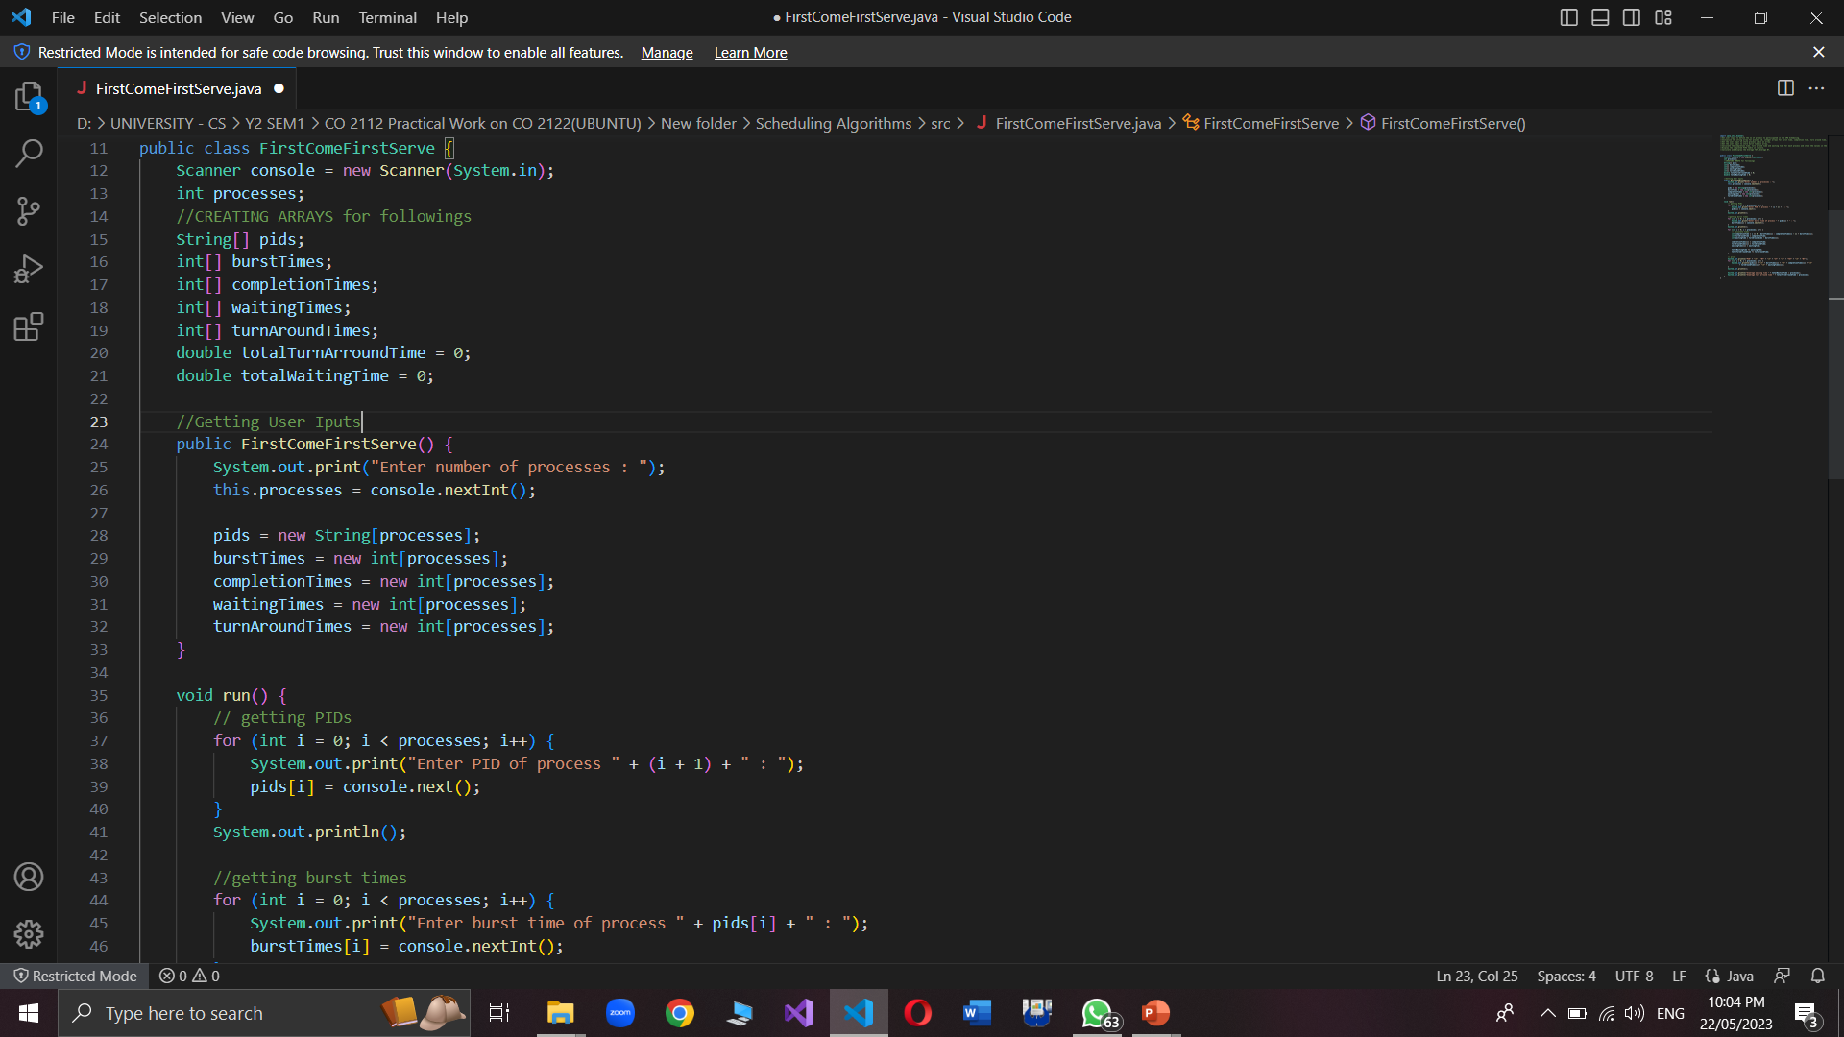
How fcfs works…

Slide 9
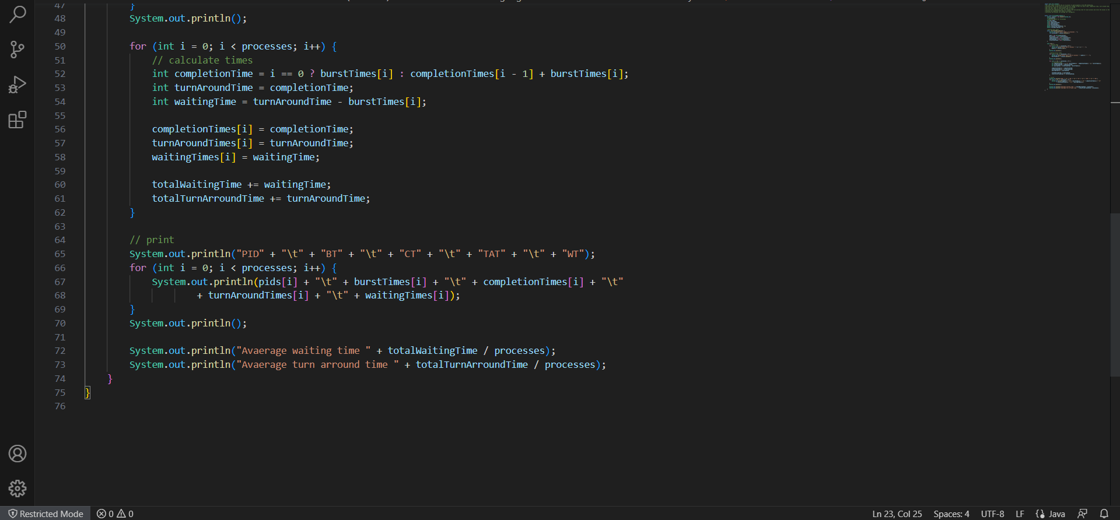
How FCFS works…

Slide 10
Advantages and disadvantages…
Advantages…
Simple implementation with First In First Out (FIFO) queue.
Disadvantages…
Response time depend on arrival order. (unfair to later jobs; specially if the system has long jobs.)

Slide 11
Comparison…
Algorithm | Allocation is | Complexity | Average Waiting Time | Pre emption | Starvation | Performance
FCFS | According to the arrival time of the processes, the CPU is allocated. | Not complex | Large. | No | No | Slow performance
SJF | Based on the lowest CPU burst time (BT). | More complex than FCFS | Smaller than FCFS | No | Yes | Minimum Average Waiting Time

Slide 12
Algorithm | Allocation is | Complexity | Average Waiting Time | Pre emption | Starvation | Performance
RR | According to the order of the process arrives with fixed time quantum (TQ | The complexity depends on TQ size | Large as compared to SJF and Priority scheduling. | No | No | Each process has given a fairly fixed time
Priority Pre-emptive | According to the priority. The bigger priority task executes first | This type is less complex | Smaller than FCFS | Yes | Yes | Well performance but contain a starvation problem
Priority non-preemptive | According to the priority. with monitoring the new incoming higher priority jobs | This type is less complex than Priority preemptive | preemptive Smaller than FCFS | No | yes | Most beneficial with batch systems

Slide 13
Group members…
EUSL/TC/IS/2019/COM/25
EUSL/TC/IS/2019/COM/35
EUSL/TC/IS/2019/COM/40
EUSL/TC/IS/2019/COM/53
EUSL/TC/IS/2019/COM/63
EUSL/TC/IS/2019/COM/92
EUSL/TC/IS/2019/COM/109

Slide 14
Thank you…!

